Slide 1

Spotify Activity Tracking
Alejandro Hohmann
Garrett Michael
Leonardo Clo

Slide 2
Problem Definition
Our company (Spotify) would like to dynamically target advertising to non-premium members based on their physical activity while using Spotify services. For example, while a listener is enjoying a podcast and folding their laundry, they would receive an ad for laundry detergent.
In addition, Spotify also wishes to cater to our premium members by enhancing music recommendation/auto-play options based on a member's physical activity. For example, while a user is exercising play up-tempo music, and while a user is eating pasta play Italian classics.

Slide 3
Data Description

Slide 4
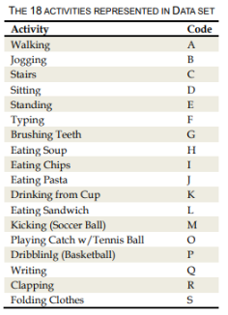
Data Description
Accelerometer (measures proper acceleration) and Gyroscope (measures orientation and angular velocity) data was collected from 51 volunteer subjects. Each subject was asked to perform 18 tasks for 3 minutes each. The 18 tasks were a mix of physical activities that could be distinctly identified, such as walking, eating, laundry, etc. We (Spotify) tried to collect data for activities that our members might be doing while using our services. The tasks are listed below.

Slide 5
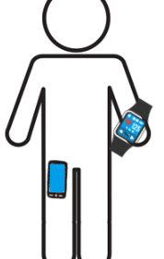
Data Description Cont.
Each subject had a smartwatch placed on his/her dominant hand and a smartphone in their pocket. The smartphone and smartwatch both had an accelerometer and gyrocope, yielding four total sensors (Phone - Gyroscope, Phone - Accelerometer, Watch - Gyroscope, Watch - Accelerometer).

Slide 6
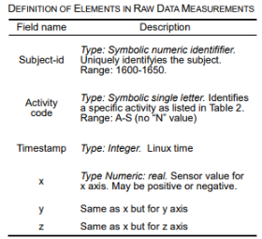
Data Description Cont.
The results for each subject are stored in a comma delimited text file. Since there are 51 subjects and 4 different sensors, there are a total of 204 text files. Each text file has the same six attributes: Subject-id, Activity Code, Timestamp, x, y, z

Slide 7
Data Preparation
Dask or Spark?

Slide 8
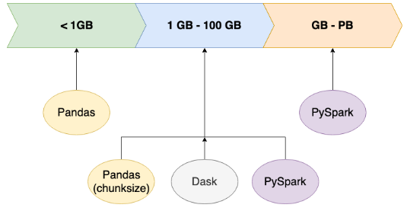
Data Preparation – Dask or Spark?
To clean, prepare and train our data, we decided to go with dask. Our reasoning was that, while our data was large (approx. 15 million records), it was not large enough to warrant the use of Spark. The image below summarizes the point.

Slide 9


Data Preparation – Dask or Spark? Cont
In addition to file size, we also wanted to use Dask because of its natural integration with python and pandas

Slide 10
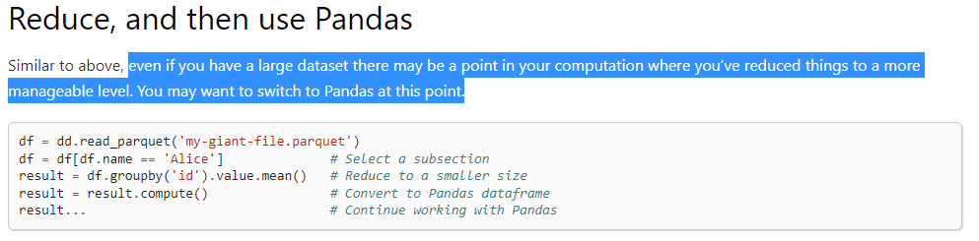
Data Preparation – Dask or Spark? Cont
Our strategy was to align with Dask best practices by using Dask to reduce the data, then switching to pandas when suitable
https://docs.dask.org/en/stable/dataframe-best-practices.html

Slide 11

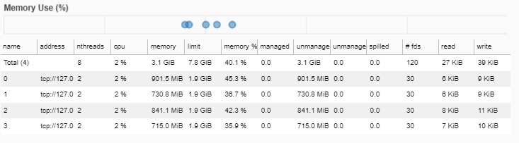
Data Preparation – Dask or Spark? Cont
Throughout this process, we leveraged the Dask dashboard to track memory usage

Slide 12
Data Preparation
Merging, Parquet and Custom Indexes

Slide 13
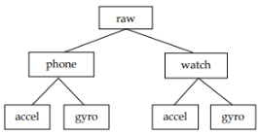

Data Preparation – Merging
The raw data is split up into 4 subdirectories, one for each device and sensor.

Slide 14
Data Preparation – Merging
Each directory contains the sensor results for the 51 subject's performance of the 18 activities.
One file per subject, per folder
51 files
51 files
51 files
51 files

Slide 15
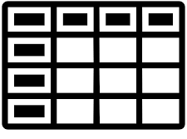
Data Preparation – Merging
We decided to append all the files from each folder, and then merge for each device
51 Files Appended
phone_df
watch_df

Slide 16
Data Preparation – Merging Problems
While our logic was sound, our approach needed improvement. The reasons are as follows:
Reading in the text files and appending was inefficient and slow
Merging was a problem, because Dask is only efficient when data frames are merged on an index

Slide 17
Data Preparation – Merging Solutions
While our logic was sound, our approach needed improvement. The reasons are as follows:
Reading in the text files and appending was inefficient and slow
Solution: Convert text files to parquet
Merging was a problem, because Dask is only efficient when data frames are merged on an index
Solution: Make a custom index

Slide 18


Data Preparation – convert to parquet
Per Dask’s best practices, we decided to convert our text files into parquet files. This saved space and shortened the time for importing data
We did this by reading each text file with pandas, and using pd. to_parquet

Slide 19
Data Preparation – Custom Indexes
Per Dask’s best practices, the best way to merge files is on the index
To leverage this, we made a custom index by combining the fields Subject-Id, Activity Code and Timestamp
df['index'] = df['subject_id'].astype('str') + df['code'] + df['timestamp'].astype('str')

Slide 20
Data Preparation – Custom Indexes
When we read each file in, we can set the index to our custom index
dd.read_parquet(file, index = 'index')

Slide 21
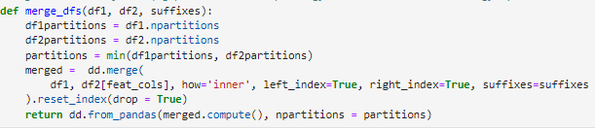
Data Preparation – Merging
After all this work we reached out goals

Slide 22

Data Preparation – Merging
After all this work we reached out goals
51 Files Appended
phone_df
watch_df

Slide 23
Data Preparation
Grouping and Cosine Similarity

Slide 24
Data Preparation – Grouping
For each sensor, data was recorded once every 50 ms (1/1000 second)
For data reduction, we grouped all results into 3 second intervals, grouping by the subject and activity

Slide 25
Data Preparation – Cosine Similarity
Since data is recorded in x,y,z axis, we thought the cosine similarity might provide more insight
Due to memory limitations/group by, we couldn’t use Dask’s built in functions
We constructed the cosine similarity by hand. The steps were as follows:
Create new columns xy, yz, xz, x^2, y^z, z^z
After group by, use the sum of each column to compute:
Cos Similarity for x and y = xy/np.sqrt(x^2*y^2)

Slide 26
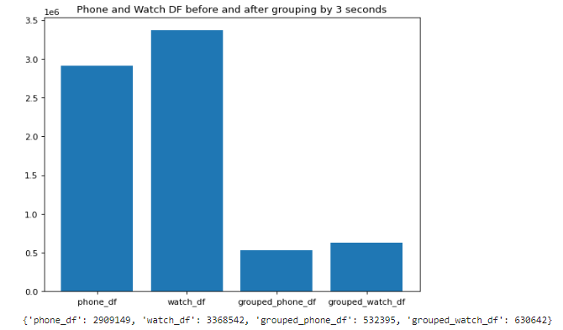
Data Preparation – Grouping
Grouping by 3 seconds allowed us to drastically reduce our data size

Slide 27
From Dask to Pandas

Slide 28
From Dask to Pandas
After all this work, we successfully leveraged Dask by reducing millions of rows
After reducing, our data was at an appropriate size to use pandas for ML models

Slide 29
Analysis Approaches
EDA on Grouped Data

Slide 30

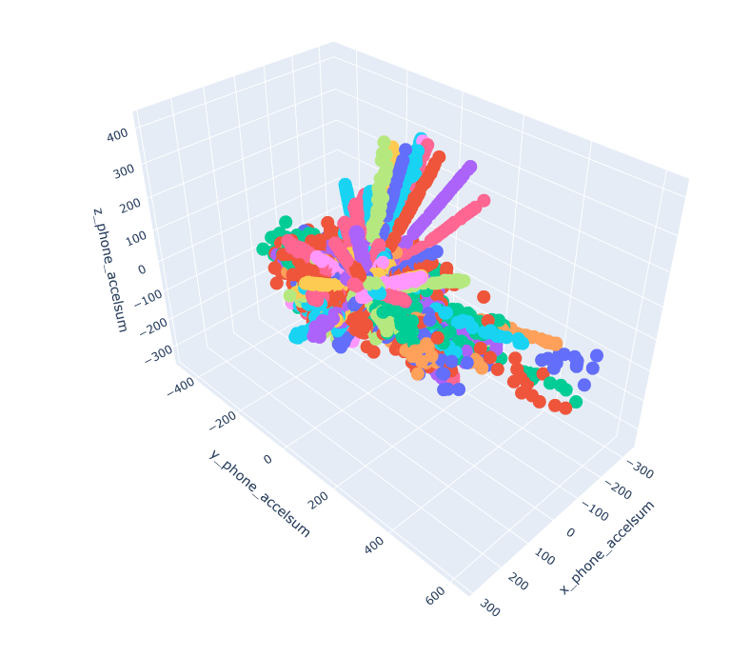
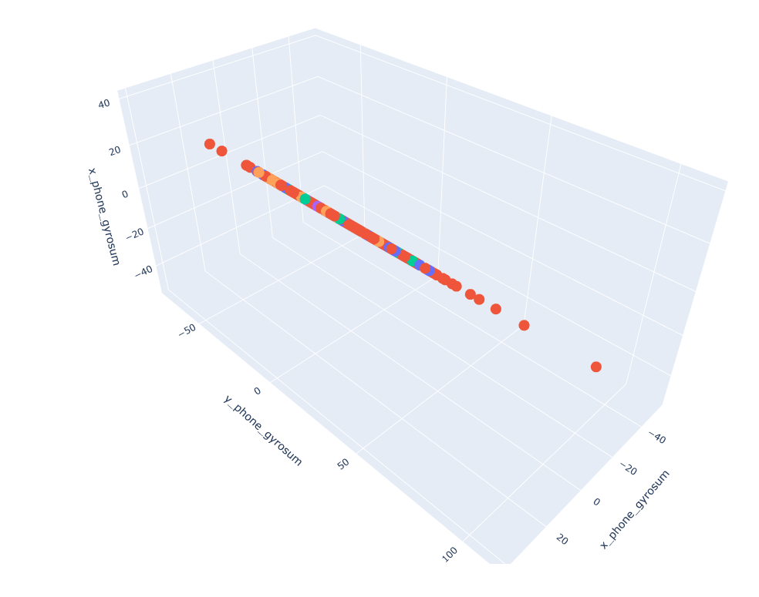
Add 3D Scatter Plots
Phone Accelerometer
Phone Gyroscope

Slide 31
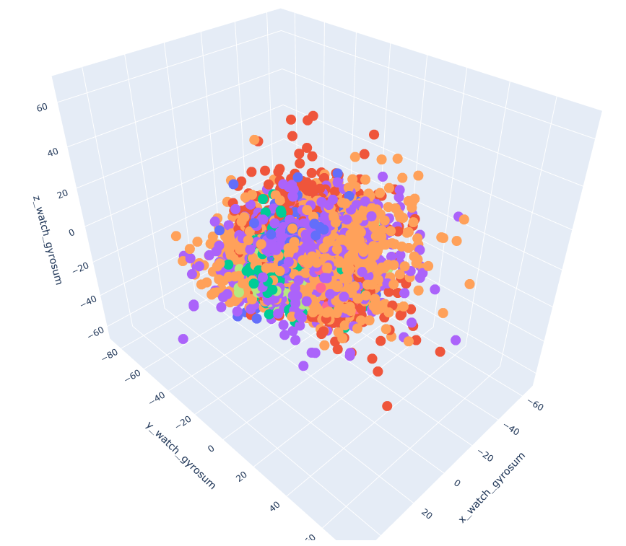
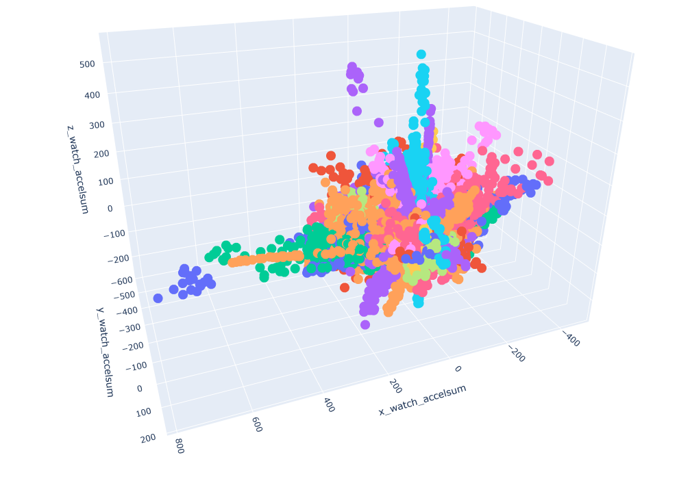
Add 3D Scatter Plots
Watch Accelerometer
Watch Gyroscope

Slide 32
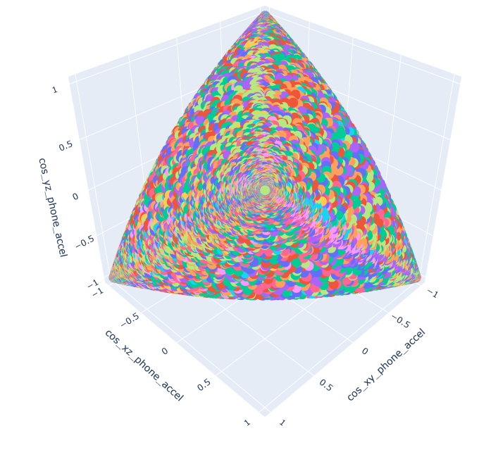
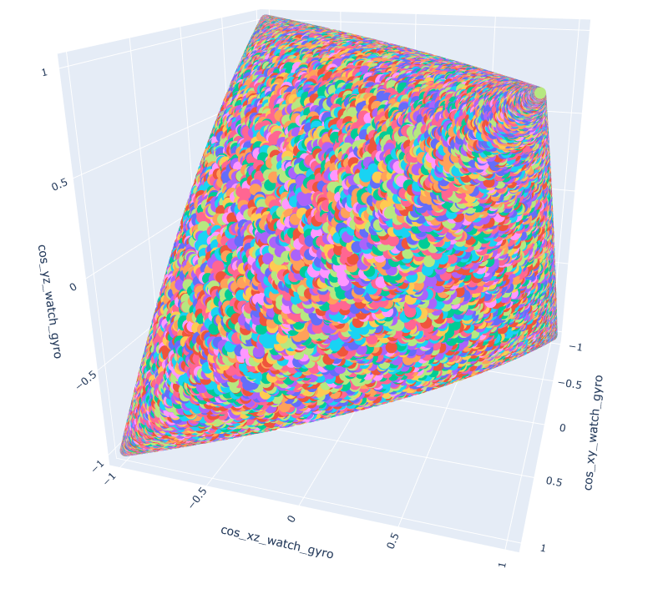
Add 3D Scatter Plots
Cosine Similarity
Phone Accelerometer
Cosine Similarity
Watch Gyroscope

Slide 33
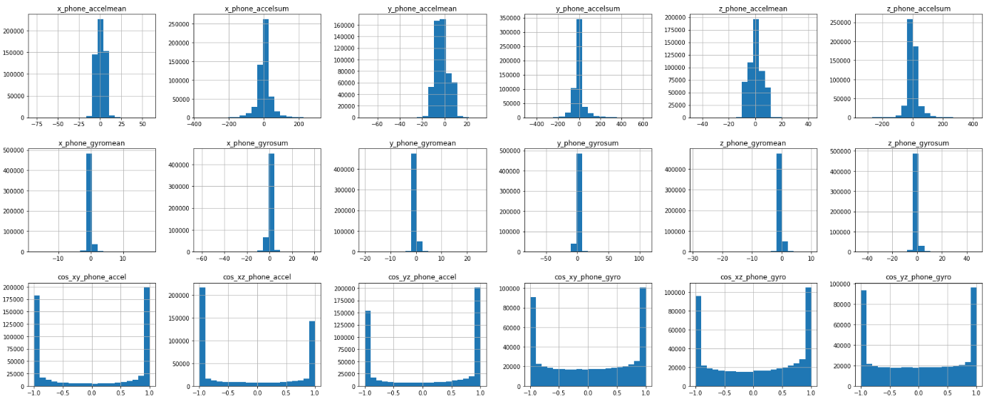

Slide 34
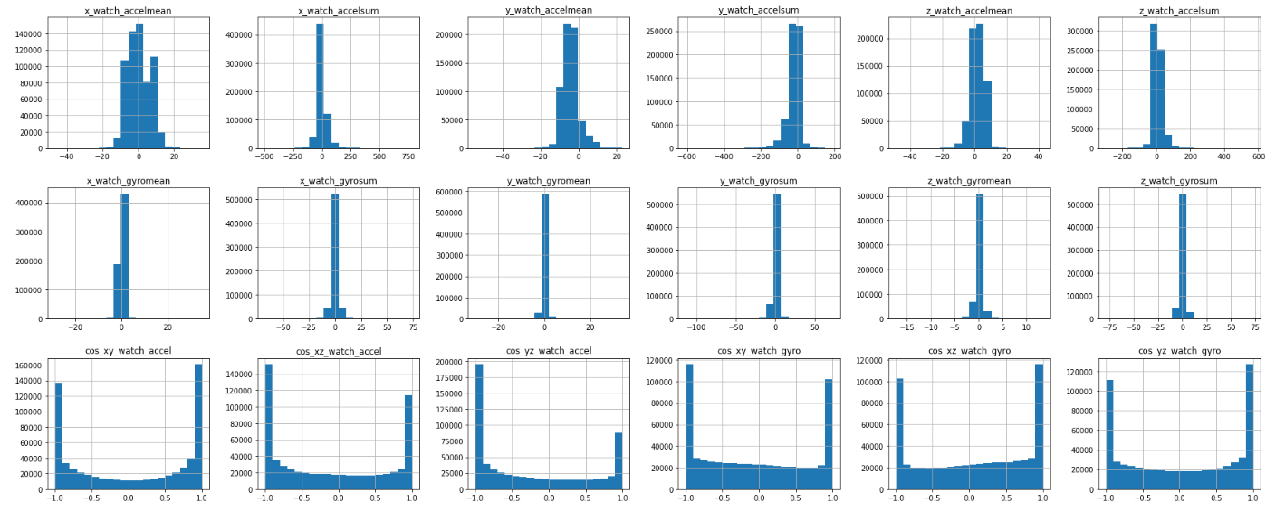

Slide 35
Analysis Approaches
Classification

Slide 36
Analysis Approaches – Classification
The dataset supports classification, with 18 possible outcomes

Slide 37
Analysis Approaches – Classification
We tried an array of different classification methods
AdaBoost
Logistic Regression
Gaussian Naïve Bayes
KNN
Decision Trees
Random Forest

Slide 38
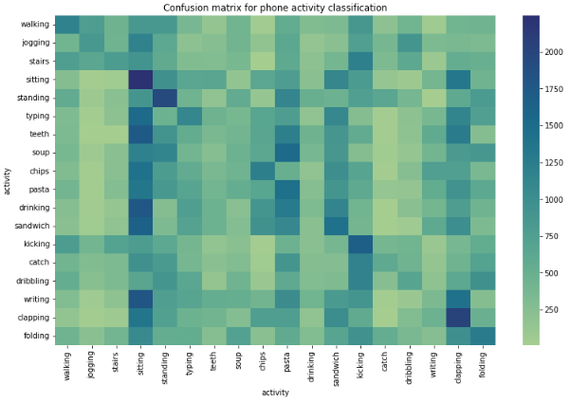
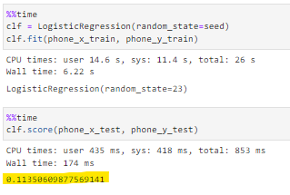
Analysis Approaches – Logistic Regression
Phone

Slide 39
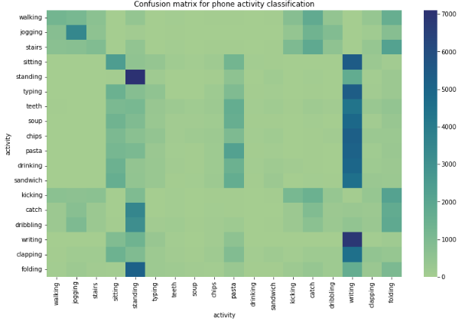
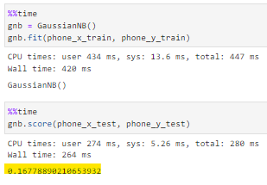
Analysis Approaches – Gaussian Naïve Bayes
Phone

Slide 40
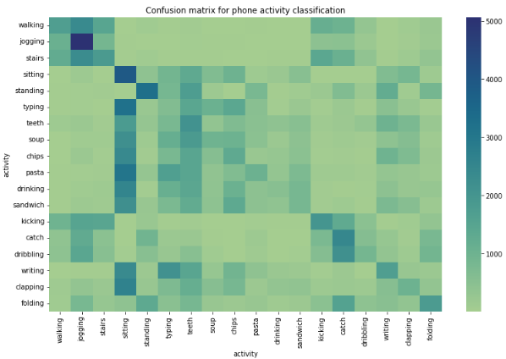
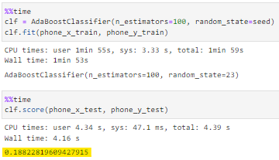
Analysis Approaches – AdaBoost
Phone

Slide 41
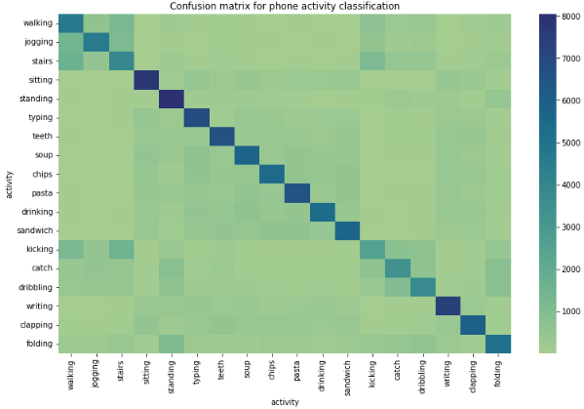
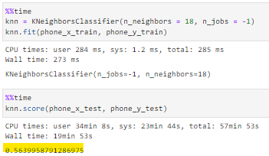
Analysis Approaches – KNN
Phone

Slide 42
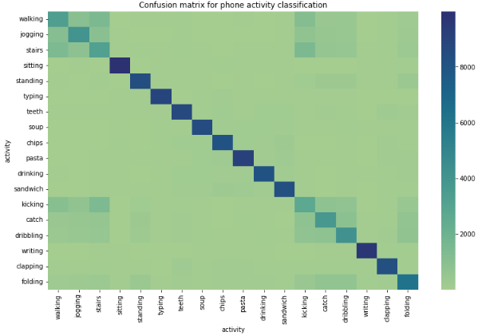
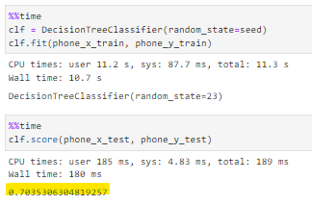
Analysis Approaches – Decision Tree
Phone

Slide 43

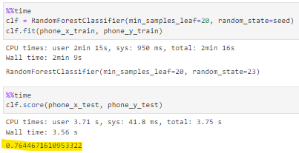
Analysis Approaches – Random Forest
Phone

Slide 44
Analysis Approaches – Gaussian Naïve Bayes
Watch

Slide 45
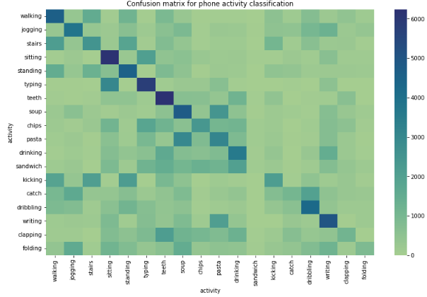
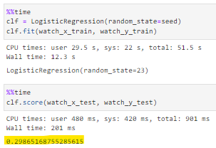
Analysis Approaches – Logistic Regression
Watch

Slide 46
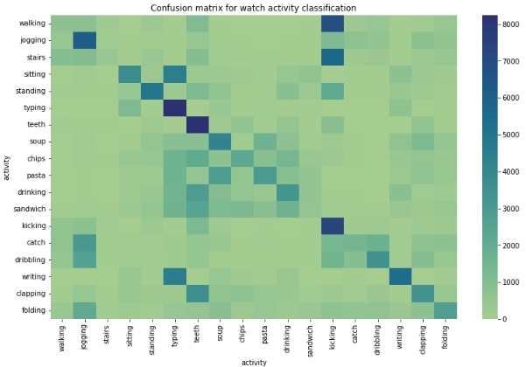
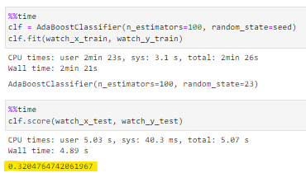
Analysis Approaches – AdaBoost
watch

Slide 47
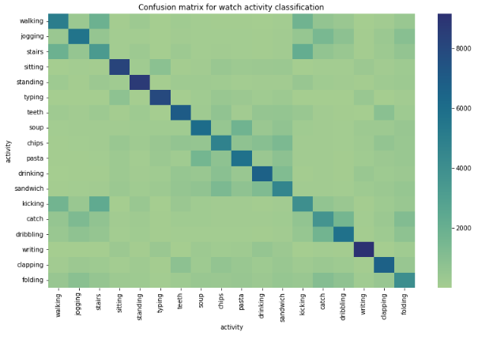
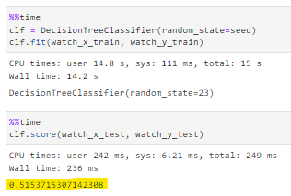
Analysis Approaches – Decision Tree
Watch

Slide 48

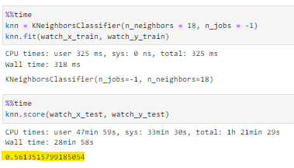
Analysis Approaches – KNN
Watch

Slide 49

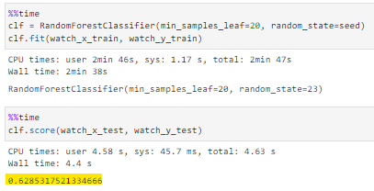
Analysis Approaches – Random Forest
Watch

Slide 50
Challenges and Approaches

Slide 51
Challenges and Approaches
While the phone and watch both had the best results for random forest, the phone was much more accurate. We will have to learn how to leverage the scores from both devices to make the best prediction
Also, grouping by 3 seconds might not be the best aggregation

